Slide 1
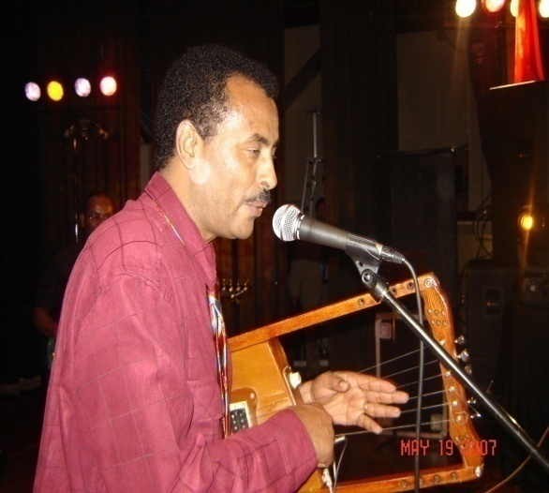
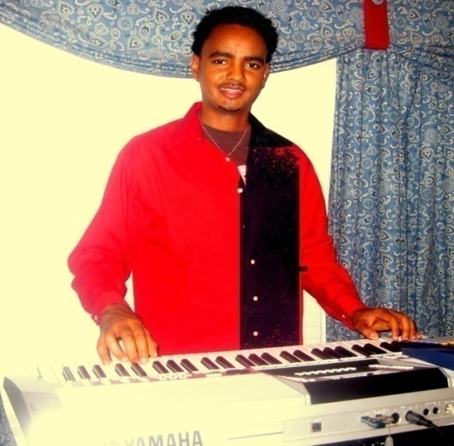
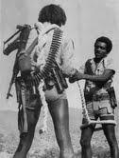
On Friday November 26th, 2010
Thanksgiving Weekend
ድምጻዊ ኣኽሊሉ ፈቶ
(TEFENO)
Eritrean in Houston & Environs
Gears up to celebrate
The 49th anniversary of armed
Struggle for our
Colorful independence.
ትውፊት ክሳብ ዝበረኸ
ሓርነት!
ኤርትራውያን ኣብ ሂዩስቶንን ከባቢኣን
መበል 49ትን ዓመት ምጅማር ብረታዊ ቃልሲ
ንሕብራዊ ናጽነትና ናይ ፈለማ ብረት ኣልዒልና
ዝተቃለስናሉ ክቡር በዓል ንምድማቅ ይሸባሸቡ።
ካብ 1961 ክሳብ 2010
ኪቦርድ ማእከለ
ተኸለማርያም
Admission: $20 in advance
at the gate will be $25
ትኬት ኣብ ደገ $20
ኣብ ማዕጾ ድማ $25
ክኸውን’ዩ
Keyboard
Maekele
Tekelemariam
Crown Reception Hall
9725 Bissonnet Houston,TX 77036
Time: 9pm to 4am
ሃገራዊ ኣውሃሃዲ ሽማግለ በዓላት ሂዩስቶን

