Slide 1
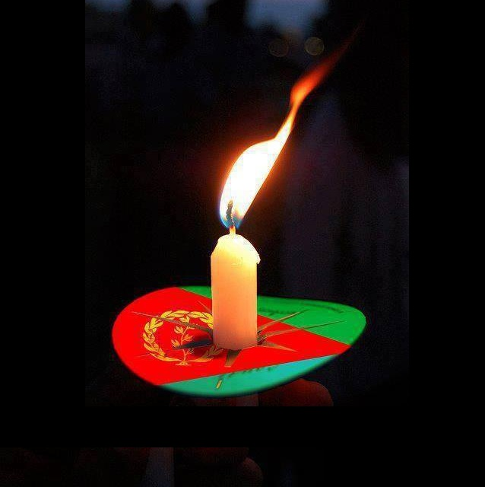
Martyr’s Day 2016 Detroit, Michigan Environs June 18, 2016 Metro Detroit area Eritrean Community and Environs remembers those who sacrificed their lives for freedom
Date: Saturday, June 18, 2016
Place: David H. Shepherd Park 24198 Church Street Oak Park, MI 48237
( Shelter 2)
Time 12:30 p.m. – 3:00 p.m.
Contacts: Kahsai Ahferom
313-585-7540 Mengisteab Tesfamikael
313-259-6579
“It is incumbent upon every Eritrean to take time out of their busy schedule to remember those who sacrificed their lives so that their fellow Eritreans can live in peace.”

