Slide 1
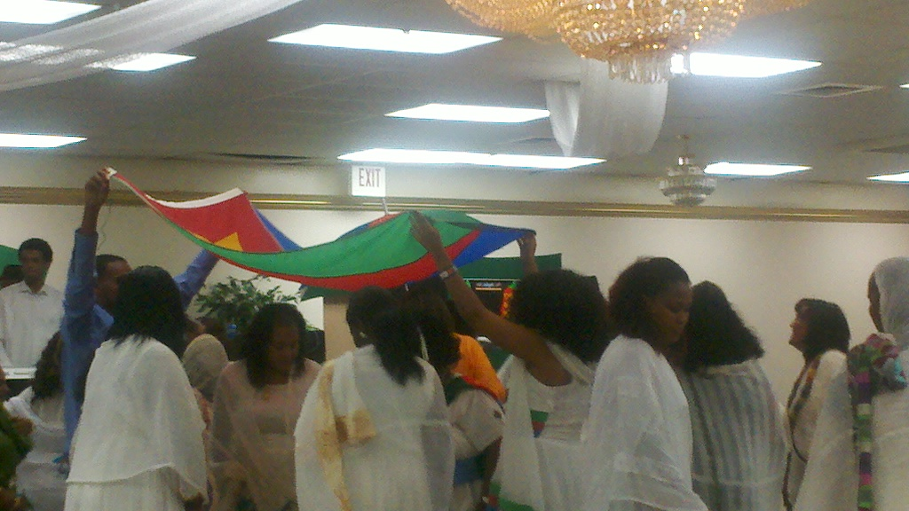
PP
ንርህው ጽባሕ ሎሚ ንስራሕ! فلنعمل اليوم لرفاهية الغد
LET US WORK TOGETHER FOR A PROSPEROUS FUTURE!
Friday/ዓርቢ 23 May 2014 Time/ግዜ 6 P.M –1 A.M.
Address/ ቦታ፡ 555 W. Glendale Ave. Phx. AZ. 85021.
Contact info: (602)518-2750, (602)327-4339. ብዳሓን ምጹ.
Admission/መእተዊ: Adults $30. Minors/ ትሕቲ ዕድመ $15

